Slide 1
Edge Fundamentals Bootcamp
Named Target Servers

Slide 2
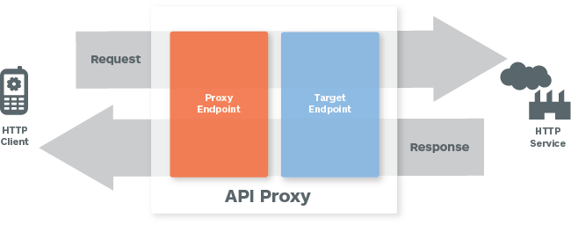
Target Servers: Hard Coded vs Parameterized
In the standard flow, target servers are hard coded
Problem: When you promote your bundle from Dev to Prod, you have to edit the Target Endpoint URL manually
Solution: Use Named Target Servers and set targets by environment

Slide 3
Existing Target URL
<TargetEndpoint name="default">
<Description/>
<PreFlow name="PreFlow">
<Request>
</Request>
<Response/>
</PreFlow>
<Flows/>
<PostFlow name="PostFlow”/>
<HTTPTargetConnection>
<URL>http://hardcoded-URL</URL>
</HTTPTargetConnection>
</TargetEndpoint>
targets/default.xml
Notes:
Rid us of "jokeindex"!!

Slide 4
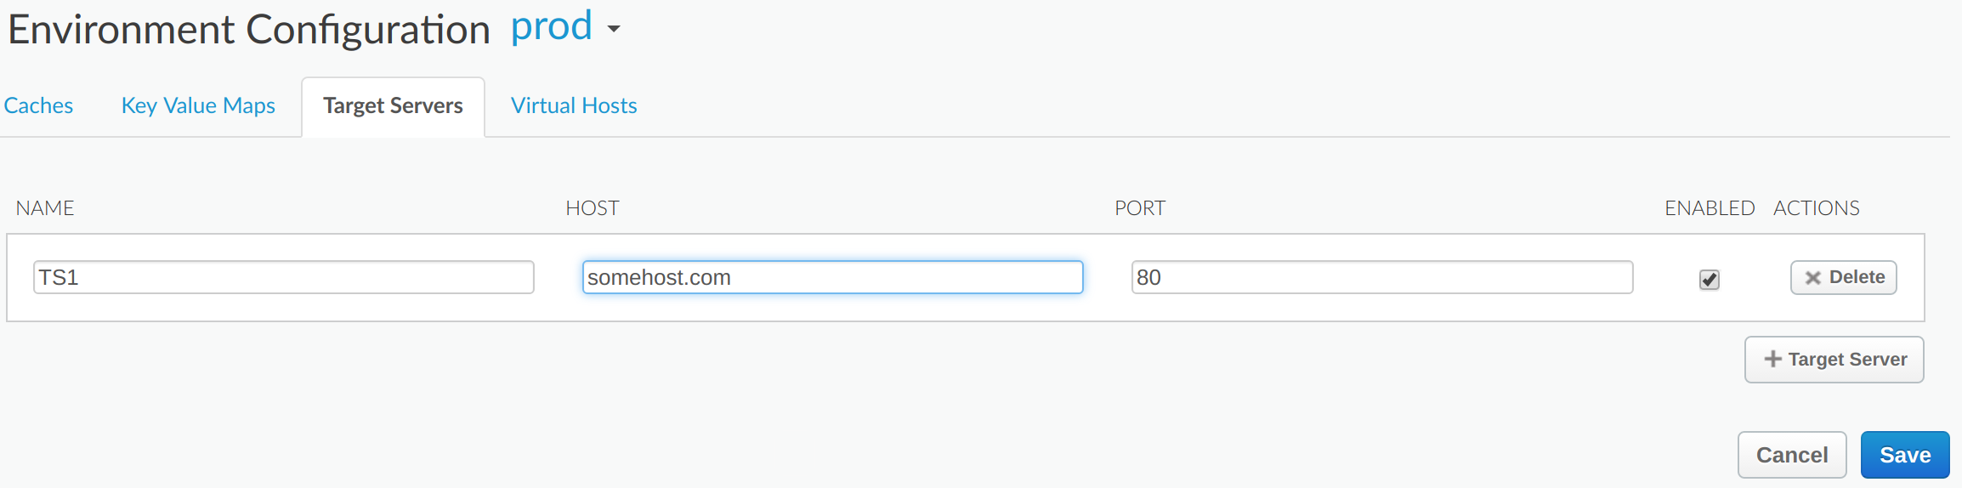
Create a Named Target Server
TargetServers are used to decouple Target Endpoint HTTPTargetConnections from concrete URLs for backend services
Target Endpoints can be parameterized for each environment (in "test" TS1 points to a somehost-test.com; and in prod to somehost.com)
When you promote the proxy with the configurations across different environments, the same code will work seamlessly without any code change

Slide 5
Load balancer
Edge enhances the availability of your API by providing built-in support for load balancing and failover across multiple backend server instances
The load balancer supports three load balancing algorithms:
Round Robin (default) - forwards a request to each TargetServer in the order in which the servers are listed in the target endpoint HTTP connection. Below is the example for such configuration
Weighted - enables you to configure proportional traffic loads for your TargetServers and distributes request to your TargetServers in direct proportion to each TargetServer 's weight.
Least Connection - to use the least connection algorithm route outbound requests to the TargetServer with fewest open HTTP connections
Other configurations that can be used:
MaxFailures - max failed requests, redirect to other target server
RetryEnabled - Retry the request once to a different server
after an I/O error
IsFallback - When the load balancer determines that all
TargetServers are unavailable, all traffic is routed
to the fallback server
<TargetEndpoint name="default">
<Description>My Target</Description>
<HTTPTargetConnection>
<LoadBalancer>
<Server name="TS1" />
</LoadBalancer>
<Path>/v1/path</Path>
<Properties/>
</HTTPTargetConnection>
</TargetEndpoint>

Slide 6
Target Server with SSL
Target servers with SSL can be configured using the Management API
<TargetServer name="TargetServer 1">
<IsEnabled>true</IsEnabled>
<Host>www.example.com</Host>
<Port>443</Port>
<SSLInfo>
<Ciphers/>
<ClientAuthEnabled>true</ClientAuthEnabled>
<Enabled>true</Enabled>
<IgnoreValidationErrors>false</IgnoreValidationErrors>
<KeyAlias>keystore-alias</KeyAlias>
<KeyStore>keystore-name</KeyStore>
<Protocols/>
<TrustStore>truststore-name</TrustStore>
</SSLInfo>
</TargetServer>

Slide 7
Health Monitoring
Health monitoring enables you to enhance load balancing configurations by actively polling the backend service URLs defined in the TargetServer configurations
Two types of health monitors
TCP - a TCP client simply ensures that a socket can be opened
HTTP - configure the HTTP client to submit a valid HTTP request to the backend service
Health monitors come into play when a backend server becomes unreachable
In a traditional load balancer configuration if a server becomes unreachable it will drop it from the pool of servers
The health monitor is designed to re-add those servers to the pool

Slide 8
THANK YOU

